Slide 1
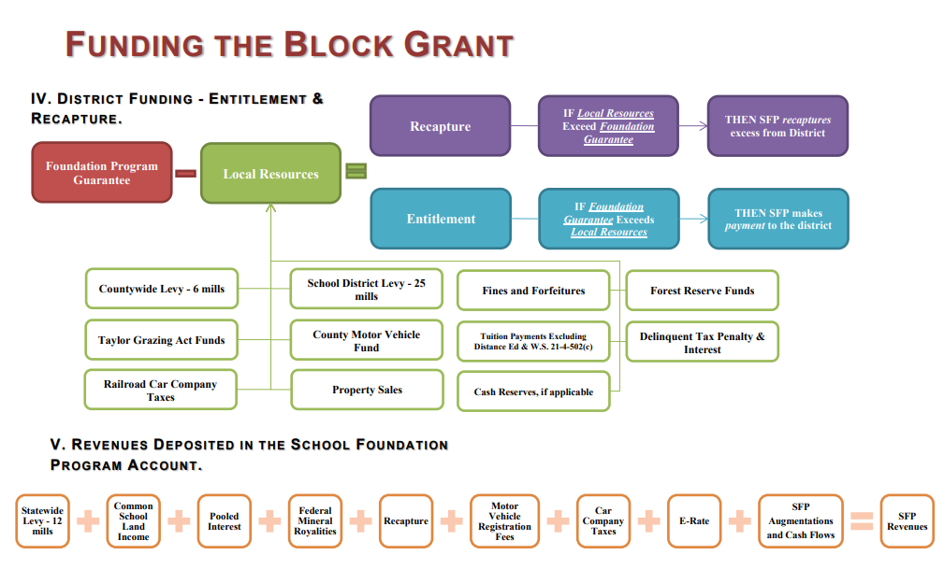

Slide 2
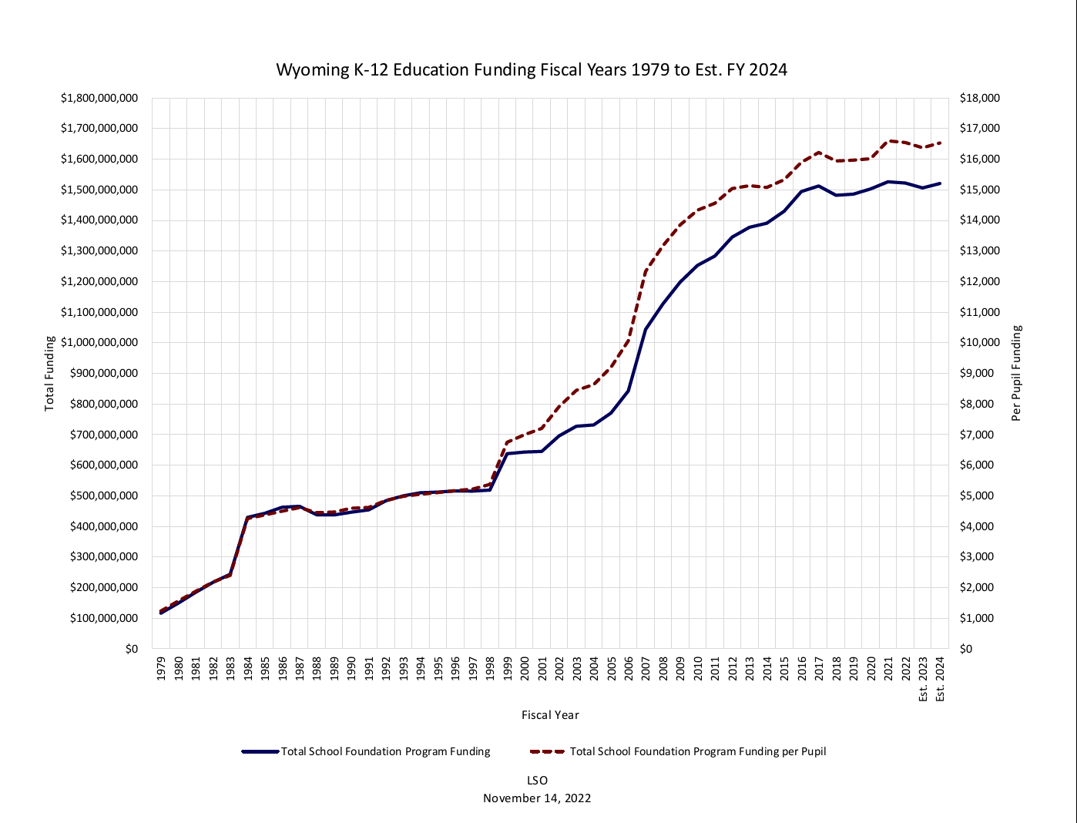

Slide 4
So What Happened?
Legislative Problem to Solve…Equity…Define…Fund

Slide 5
There are four approaches that are commonly used for Education Cost Studies:
evidence-based approach;
(ii) successful school/district approach;
(iii) professional judgement panel approach; and (iv) statistical model approach.

