Slide 1
Wyoming Tax System REQUIRES Minerals
Note- Wyoming has no personal or corporate income tax!

Slide 2
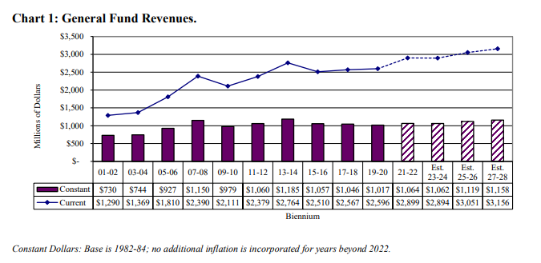
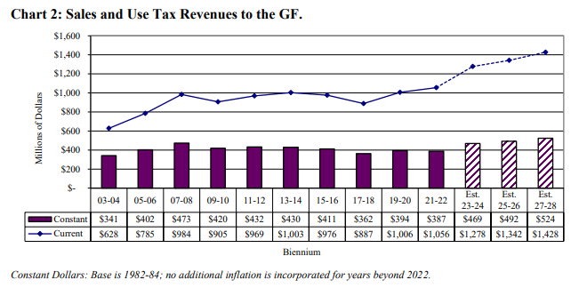
Projected Oil, Gas and Coal
Production Value Outcomes 2023-2028:
Total GF revenues projected to rise by 9% 2023-2028
Oil:
-9%
Coal:
-34%
Total S/U Tax revenues projected to rise by 11.7% 2023-2028
Nat. Gas:
-41%
Source: CREG October 2023,

Slide 3
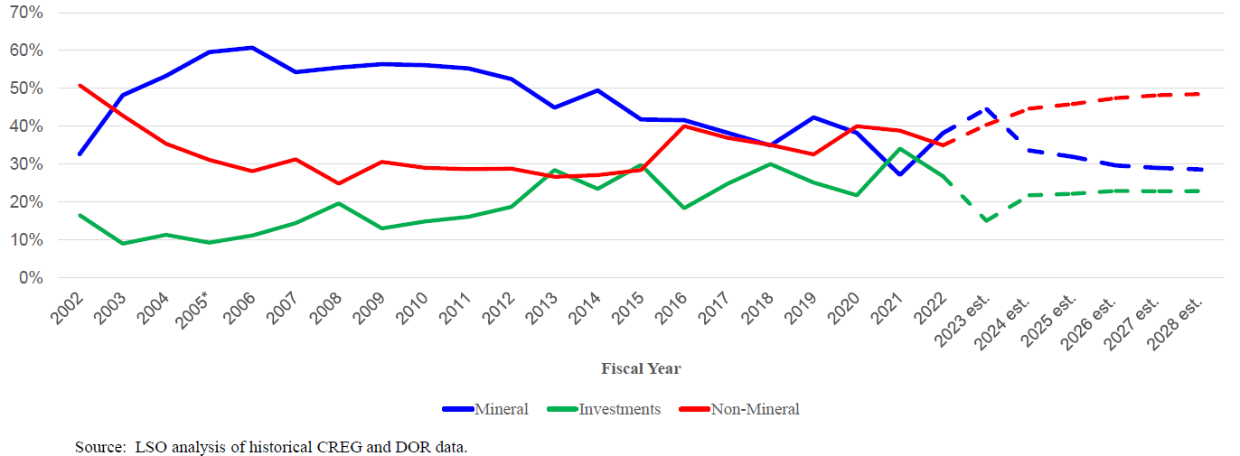
State Revenue Adjustment under Current Tax Models
Actual
Estimated
Slide courtesy Don Richards – presented at Wyoming State Treasurer’s Investment Conference, 8/29/23 Jackson WY

Slide 4
How much do we need to replace Energy-supported State Spending?
Slide courtesy Don Richards – presented at Wyoming State Treasurer’s Investment Conference, 8/29/23 Jackson WY

