Slide 1
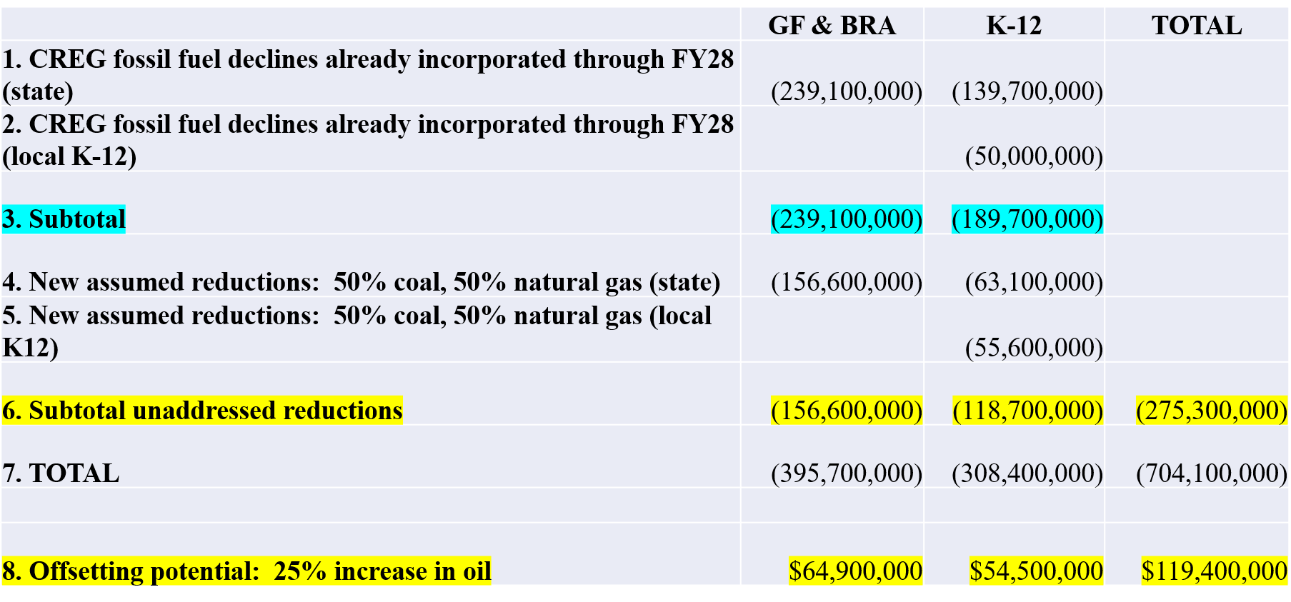
Generally speaking, the State’s budget is composed of three revenue sources: mineral income; sales and use tax; and investment income from States funds. It is highly “probable” that our income will be lower in 2030.

Slide 2
Takeaways / Problem Statement
- Wyoming’s tax structure, and thus government and school district operations, rely heavily on mineral extraction. (historical foundation of exporting tax base) - Two of the three main mineral resource revenues have declined precipitously in the last 15 years. The third has among the most volatile pricing characteristics and just recently has arrested its decline. - For a majority of the last decade, there is a revenue/expenditure disconnect. - From the investment standpoint, we only distribute “earnings”. These are defined as interest income, dividends and realized capital gains. This is a very archaic way to define income. We could have a 100% return and distribute $0 under this definition.
Source: TAC presentation 8-23

