Slide 1
Major Components of
Wyoming’s Tax Structure
Property Tax - 47%
Property tax for mineral production 51% of FY23 total
Effective tax rate on owner-occupied housing value 0.56% (#47)
General Sales Tax - 26%
State tax rate 4%, avg. local rate 1.36% = 5.36% combined rate (#43)
Severance Tax - 22%
6% of value on oil & gas, 4% on stripper oil
7.0%* of value on surface coal, 3.75% of value on underground coal. 6.5% as of January 1, 2021
Other Taxes - 5%
Fuel tax $0.24/gallon (#38)
Cigarette tax $0.60/pack (#43)
Alcohol – Beer $0.02/gallon (#50), Wine $0.28/gallon,
Spirits $0.94/gallon (no ranks)
Insurance premium tax
Franchise tax
Wind generation tax
NO INDIVIDUAL INCOME TAX
NO CORPORATE INCOME TAX
Source: Wyoming Legislative Service Office Fiscal Profile 2023, Wyoming Department of Revenue, Tax Foundation
Notes:
So what do our revenues look like today?
Everyone in the state of Wyoming enjoys no individual or corporate income tax so we rely heavily on property and sales tax.
In FY 2021, 52% was raised through property tax of which 45% of the property tax was accounted for through mineral production.
General Sales tax accounts for 33%
While Severance tax accounts for 9% of Wyoming’s revenues.
Other taxes equate for about 6% which include things like fuel tax, cigarette and alcohol taxes, insurance premium taxes, franchise taxes and the wind generation tax.

Slide 2
2023 Property Tax – How it is derived
How It’s Derived
($ Millions)
Mineral Production | $1,144
Residential Property | $639
Industrial Locally-Assessed | $160
Industrial State-Assessed | $91
Commercial Property | $138
Agricultural Lands | $28
TOTAL TAX REVENUE: | $2,200
Source: Wyoming Department of Revenue, FY 2023

Slide 3
2023 Property tax – How it is used
How It’s Used
($ Millions)
Public Schools | $1,524
County Government | $385
Special Districts | $172
Community Colleges | $78
Cities and Towns | $41
TOTAL: | $2,200
Source: Wyoming Department of Revenue, FY 2023

Slide 4
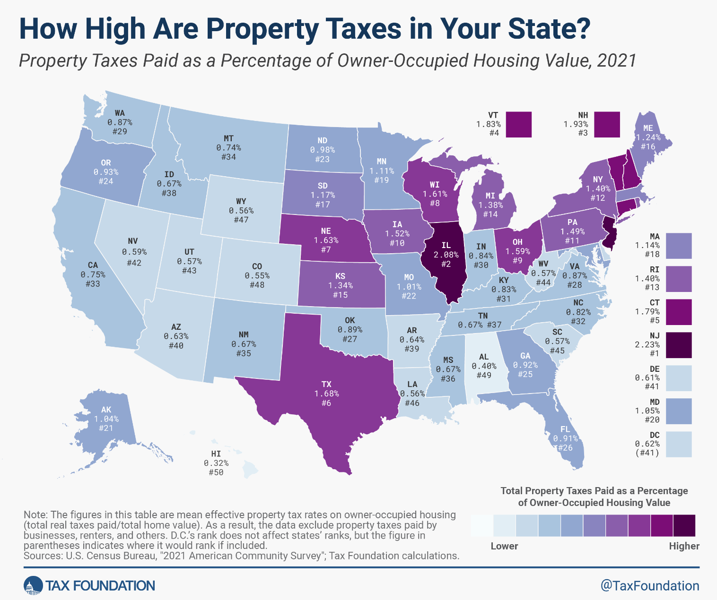
Residential Property Tax -
How Does Wyoming Compare?
Notes:
Wyoming ranks 47th or the 4th lowest effective property tax value. Other states include Colorado, Alabama, Hawaii

Slide 5
Major Components of Wyoming’s Tax Structure
How Does Wyoming Compare?
 | Sales Tax Rate (%) | Income Tax Rate (%) | Property Tax Burden ($)
Montana | 0% | 6.75% | $ 3,640.00
Colorado | 7.79% | 4.40% | $ 2,730.00
South Dakota | 6.11% | 0% | $ 4,725.00
Nebraska | 6.97% | 6.64% | $ 6,965.00
Utah | 7.20% | 4.85% | $ 2,625.00
Wyoming | 5.44% | 0% | $ 2,503.00
Sources: Wyoming Department of Revenue, Tax Foundation

Slide 6
Direct Tax Collections &
Public Service Costs 2021
For a 3-person family with income of $67,000 and owning a home valued at $290,000
Personal Tax Collections
Retail Sales $ 1,150
Gasoline $ 210
Cigarettes $ 120
Alcohol $ 110
Vehicle Registration $ 600
Property Tax $ 1,780
Public Service Costs
County $ 2,810
City/Town $ 3,070
Special District $ 6,290
K-12 Education $ 7,570
State Services $ 7,810
$27,550
$ 3,990
Source: Department of Administration & Information, Economic Analysis Division 2022
NOTE: Excludes Federal Funds and Enterprise Revenues
Notes:
According to the Economic Analysis Division in the State Department of A & I, the 3-person family with an income of $67,000 and owning a home valued at $290,000 the average tax collected is $3,990 while the public service costs of $27,550 for services which include things like law enforcement, public works, leisure and rec, transportation, healthcare and education.
To simplify this equation, know that every $ 1 the average Wyoming citizen pays in taxes results in $6.90 in public service.
I would like to NOTE - this does NOT include Federal funds - In 2020 Wyoming citizens and businesses sent over $6.4B to the federal govt in and received $7B back in payment – employment, support of our parks, federal matching $ roads, etc. There is overall a very low personal tax burden

Slide 7
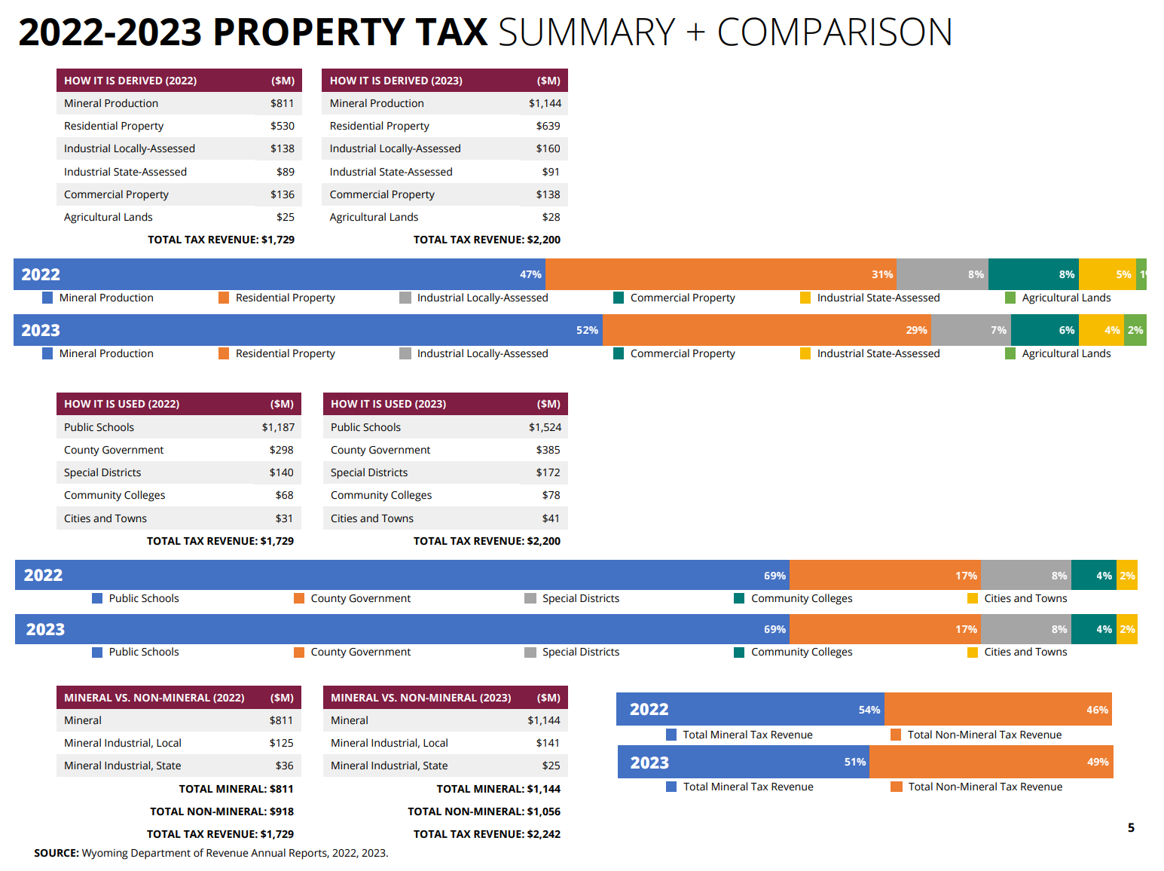
Wyoming Property Tax 2023

