Slide 1
The New Property Tax Revolt
Jared Walczak, Tax Foundation jmw@taxfoundation.org

Slide 2
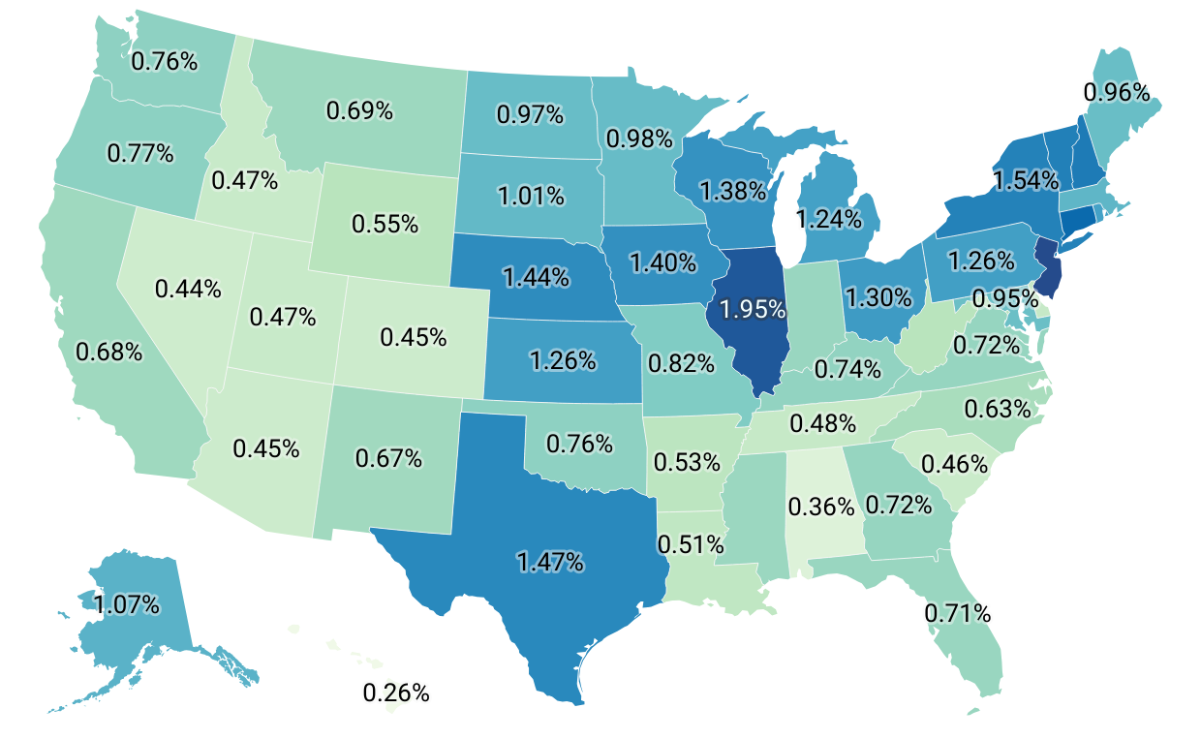
Homeowners’ Effective Rates

Slide 3
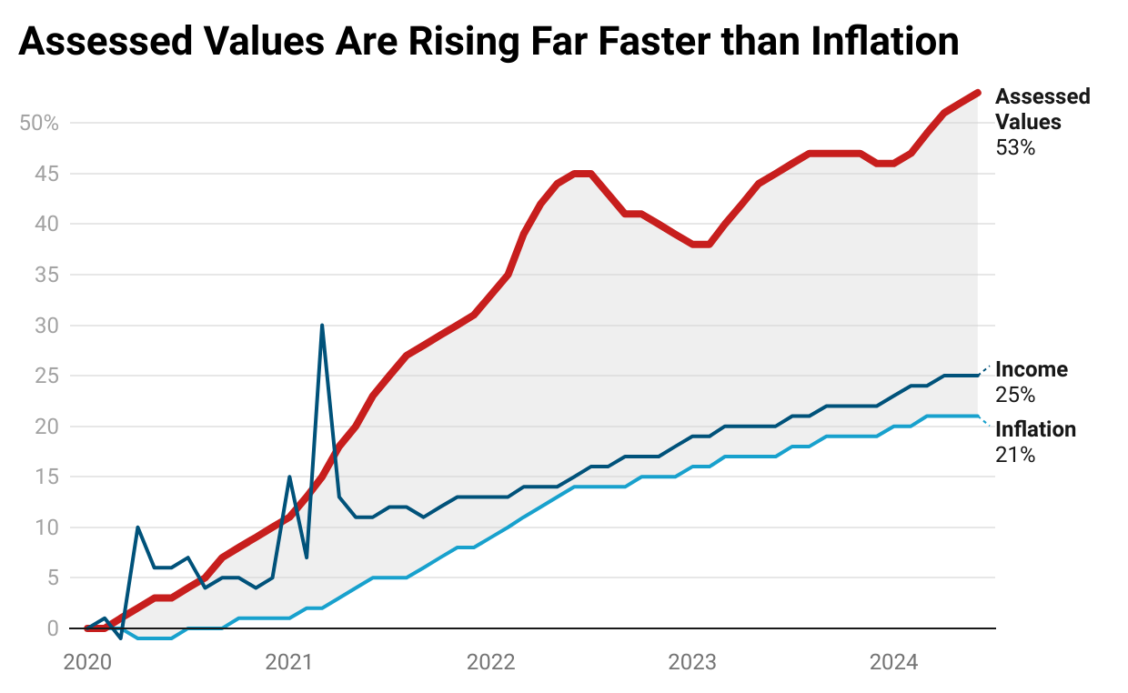
Assessed Values Rising Faster than Inflation
Nationally, up: 53.1% in nominal terms 26.6% in real terms
Start date January 2020. Personal income is adjusted for population growth. Sources: Census Bureau; Bureau of Economic Analysis; Case-Shiller Home Price Index.

Slide 4
Wyoming is Below National Averages
In Wyoming: 44.7% in nominal terms 19.6% in real terms
Start date January 2020. Personal income is adjusted for population growth. Sources: Census Bureau; Bureau of Economic Analysis; Case-Shiller Home Price Index.

Slide 5
Property Tax Repeal Proposals in 2024
Florida (study proposal on elimination)
Nebraska (EPIC ballot initiative, failed to make ballot)
North Dakota (citizen initiative)
Texas (using compression to eliminate property taxes over time)
Wyoming (raise sales tax to eliminate tax on most residences, failed)

Slide 6
Property Tax Basics
One of the few revenue generators available to local governments, hence the need under the ballot measure to backfill the lost revenue.
Generally Recognized Benefits of Property Taxation:
Transparent
Neutral
Comports with the Benefit Principle
Often Self-Reinforcing

Slide 7
The Case for Property Taxes
Property taxes do less economic harm than alternative ways to raise the same amount of revenue, making them more economically efficient than the alternatives.
Property taxes have less of an effect on decision-making—including location decisions—than most other taxes, making them less distortionary than the alternatives.
Property taxes roughly align with the benefits that property owners receive from local services, making them more equitable than the alternatives.
Property taxes are highly transparent and correlate strongly with services that enhance the value and utility of property, making them unusually sensitive to local preferences on size and scope of government.

Slide 8
Economic Efficiency of Property Taxation
A 1 percentage point shift from income taxes to sales taxes improves GDP by 0.74%, while shifting to property taxes increases GDP by 1.45% ~ Arnold, Brys, Heady, Johansson, Schwellnus, & Vartia, Economic Journal
A 1 percentage point shift from income to consumption taxes increased GDP by 0.92%, while a shift to property taxes yielded a 1.22% GDP improvement ~ International Monetary Fund
Gross state product decreases by 2.8% when the income tax replaces the property tax, while household income declines by 3.47% ~ Faulk, Thairprasert, & Hicks, Ball State working paper
While a 1 percentage point higher rate on personal property reduces annual employment growth by 2.44%, higher real property taxes actually correspond to modestly increased rates of employment growth, likely because the business benefits of higher local spending are greater than the additional tax costs ~ Mark, McGuire, & Papke, National Tax Journal

Slide 9
Why are Property Taxes More Efficient?
Land is a fixed asset
The supply of land itself does not change with property taxes, and elasticities on supply of housing are favorable
Does relatively little to distort economic decision-making
Even taxing improvements isn’t as harmful as it might be, since the tax on the value of unimproved land encourages efficient land use
Does not penalize productivity or consumption
Contrasts with income and sales taxes, which reduce incentives to work, invest, or consume
Tax is capitalized into home prices
Can’t avoid impact of increase by moving

Slide 10
Conceptual Models of Property Tax
Capital Tax View Tax on capital investment in property
Benefit View Charge for benefits received by property

Slide 11
Property Tax Limitation Typology
Overall Constraints
Levy Limits
Rate Limits
Assessment Limits
Full Repeal
Other Mechanisms
Circuit Breakers
Homestead Exemptions
Tax Rebates or Swaps

Slide 12
States with Assessment Limits
Arizona
Arkansas
California
Colorado
Connecticut
District of Columbia
Florida
Georgia
Hawaii
Iowa
Louisiana
Maryland
Michigan
New Mexico
New York
Oklahoma
Oregon
South Carolina
Texas

Slide 13
The Effects of Assessment Limits
Current Property Tax on an LA Home Worth $1M in 2023, By Acquisition Year
Annual Property Tax if acquired in…
1975: $451
1985: $1,380
1995: $2,095
2005: $5,849
2015: $5,755
2023: $10,000
Sources: U.S. Federal Housing Finance Agency; State of California Department of Finance; Tax Foundation calculations. Uses All-Transactions House Price Index to set acquisition price by year and applies Prop 13 limitations (the lesser of CA CPI-U or 2%) for each year.

Slide 14
Assessment Limits and Housing
Shifts tax burdens onto newer (and younger) homeowners, making the tax cost of housing less affordable for those who may be the most income-restricted
Tax capitalization may be limited or uneven
May deter new construction much as impact fees do
Creates lock-in effect that discourages relocation or renovation
Affects both downsizing and upsizing
If new construction is constrained by other factors (e.g., permitting or land use restrictions), or lots are limited, this creates incentives to build bigger—making it even more detrimental if older stock doesn’t recirculate
Can worsen housing affordability for first-time homebuyers

Slide 15
Multiple Possible Effects
To the extent that property taxes are capitalized into home values, lower taxes (through any limits) may increase home acquisition prices, though long-run costs should still be lower
However, not all limits will have the same effect, and an overall effect cannot tell us what the effect is on new properties or new market entrants
To the extent that reduced tax collections also reduce service provision, this can also reduce home prices—though mileage may vary on whether this is a win for affordability

Slide 16
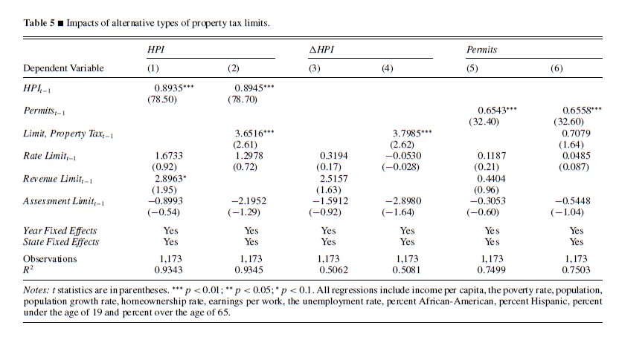
Multiple Possible Effects
Impact of Property Tax Limits on Home Value, Hoyt 2010
Effects on Home Prices:
Levy Limit +1.7%
Assessment Limit Negative but not statistically significant

Slide 17
Property Tax Limitation Typology, cont.
Overall Constraints
Levy Limits
Rate Limits
Assessment Limits
Full Repeal
Other Mechanisms
Circuit Breakers
Homestead Exemptions
Tax Rebates or Swaps

Slide 18
Questions?
Jared Walczak, Tax Foundation jmw@taxfoundation.org

